Slide 1
Prototyping Smarter Patient Discharge Summaries
Mason Kim, Aditya Deshmukh, Nicolle Vigil, Yoko Kentilitisca
April 19, 2025

Slide 2
Agenda
Problem Statement
Technical Overview
Deployment Considerations
Limitations

Slide 3




Physicians devote substantial time to administrative tasks alongside patient care
Problem Statement
The average doctor spent 8.7 hours per week on administrative tasks
Physicians spend a significant amount of time on administrative tasks, including writing discharge summaries, which reduces time available for direct patient care. The goal of this project is to develop a prototype that uses Large Language Models (LLMs) to automatically generate patient discharge letters based on inpatient data.
Work Time
Days
33.4%
8
33.4% of physician’s time is spent on non-patient-facing EHR, administrative and other tasks
Physicians at John Hopkins took a median of eight days to complete discharge summaries.
Minutes
Savings
5
$350,000
Hospitals recommend that physicians reserve about 25% of every patient visit (5 minutes of a 20 minute visit) for admin work like inbox management.
One report estimates potential annual savings for the hospital budget are over $350,000 by Improving the efficiency of discharge summary completion
Source: https://peoria.medicine.uic.edu/administrative-tasks-take-up-more-time-than-patient-care-for-many-pcps/

Slide 4
Technical Overview
Goal: The goal of the project is to develop a prototype using Large Language Models (LLMs) that can automatically generate patient discharge letters based on inpatient data, reducing administrative burdens and improving efficiency in healthcare settings.

Slide 5
Three Different Approaches for Generating Patient Summaries
Direct JSON-to-LLM Pipeline
Conditional Preprocessing + LLM
RAG-Enhanced Retrieval with LLM
Raw JSON files were fed directly into ChatGPT using structured prompts
Pros: Fastest setup; low preprocessing overhead.
Raw JSON was preprocessed into semi-structured natural language chunks.
Pros: Improved control and interpretability; avoided unnecessary API calls
1. JSON fields were processed into natural language and sample discharge summaries tokenized and embedded using vector representations.
2. RAG fetched relevant context from the embeddings.
3. LLM used this retrieved context to generate coherent summaries.
Pros: Scalable and modular; provided customization.

Slide 6
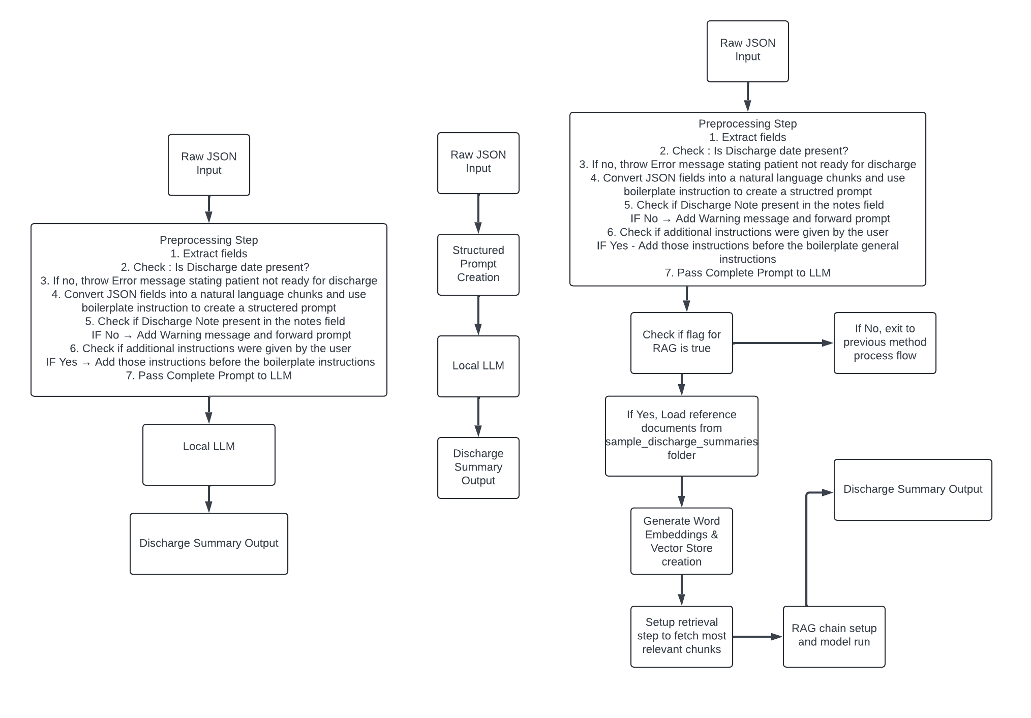
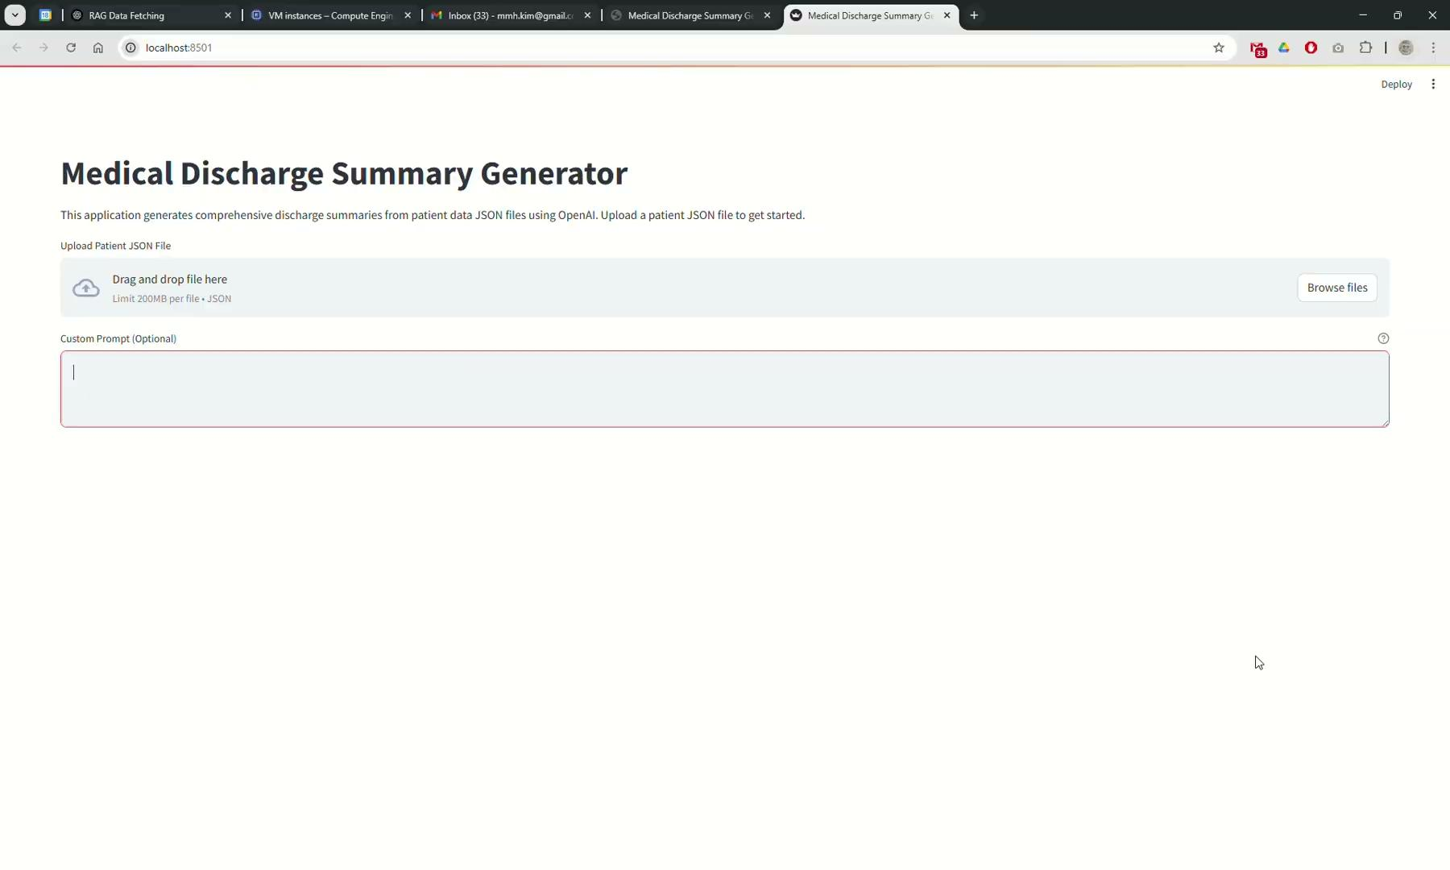
Direct JSON to LLM Pipeline

Slide 7

Conditional Preprocessing+LLM

Slide 8

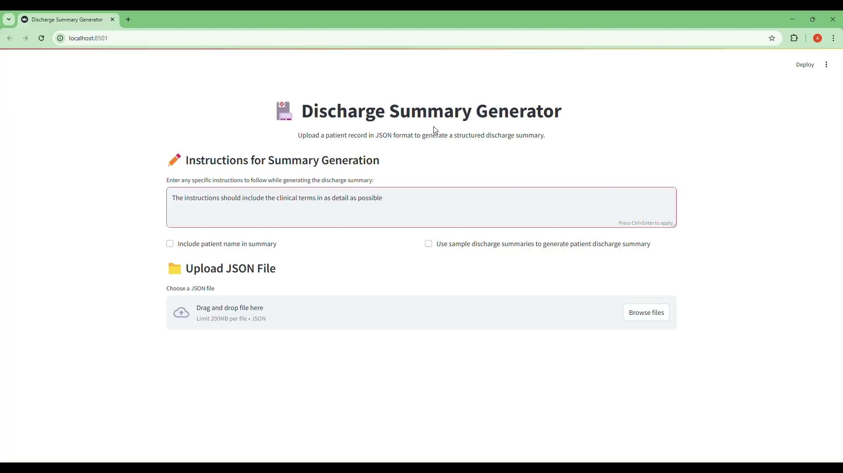
RAG-Enhanced Retrieval with LLM
We used RAG-generated discharge summaries as structural references to guide output formatting. RAG was later used in the evaluation phase to validate the efficiency and quality of our prototype’s outputs

Slide 9
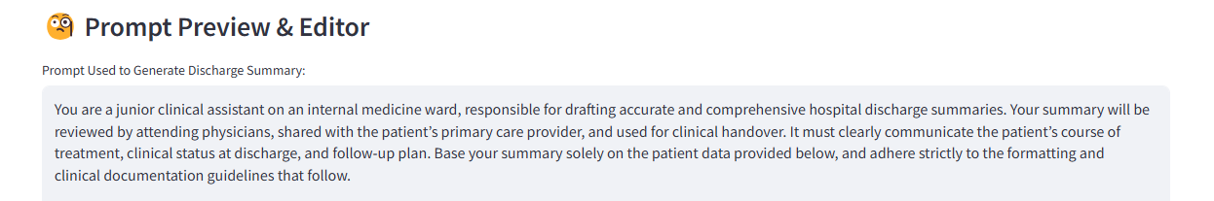
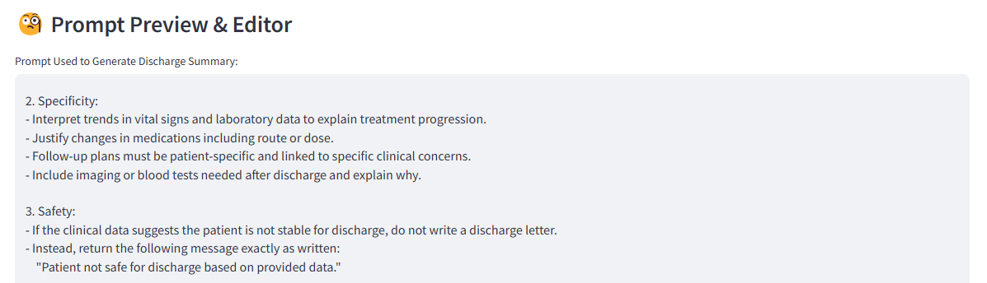
Prompt Engineering Strategies Used
Role Prompting
Chain-of-thought Prompting

Slide 10
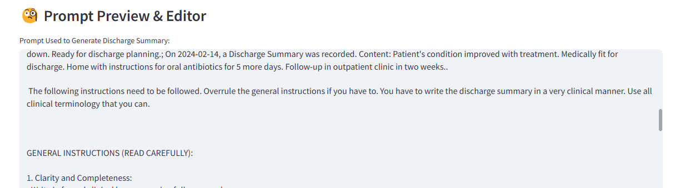
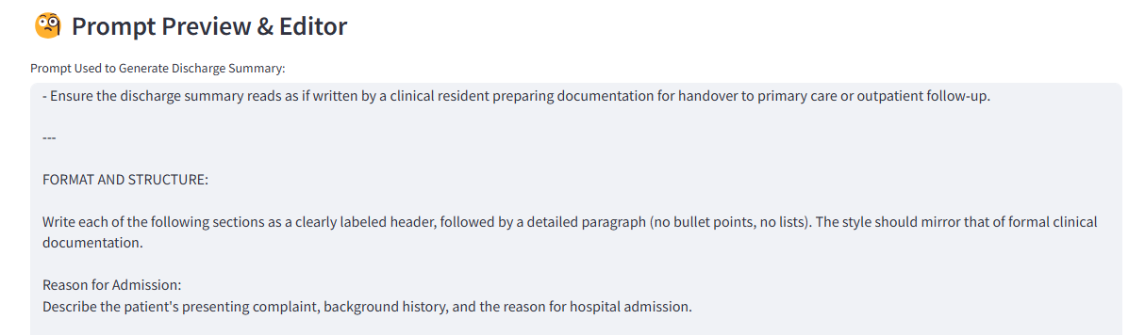
Continued: Prompt Engineering Strategies Used
Instruction Prompting
Output-Structured Prompting

Slide 11
Analytics & Insights

Slide 12
Use Cases, Pros, and Cons for Each Process
Direct JSON-to-LLM Pipeline
Conditional Preprocessing + LLM
RAG-Enhanced Retrieval with LLM
Best Use Case: Short JSON files with limited fields.
Pros: Fastest setup; low preprocessing overhead.
Cons: Risk of missing contextual dependencies or misinterpreting nested fields due to lack of structure.
Was not able to differentiate between when a discharge summary should be generated and when not to.
Best Use Case: When data needs to be cleaned, filtered, or selectively included before prompting the LLM.
Pros: Improved control and interpretability; avoided unnecessary API calls
Cons: Additional preprocessing steps require understanding of the JSON file structure.
Best Use Case: Suitable for large data files. Possibly patients with extensive medical history.
Pros: Scalable and modular; provided customization.
Cons: Most effective for large or incomplete datasets requiring specific and unique context fetching.
Requires a store of complete dataset to be retrieved. Current implementation limited.

Slide 13
Strengths of Current Approaches
Structured and Clear Summaries
Secure Local Deployment with LM Studio
Consistent format makes discharge letters easy to read and understand
Improves communication between providers and patients
Model runs locally which ensures privacy
No patient data leaves the system, making it HIPAA-compliant
Built-in Review Process
Standardized Across Cases
All summaries share the same framework
This reduces confusion and maintains quality
Clinicians review AI-generated drafts
Enhances accuracy and reduces errors
Smart Use of AI Models
Patient- and Provider-Friendly Output
LLMs produce complete, well written summaries
Supports clinical decision making
Easy to read format for users
Improves transparency and patient understanding

Slide 14
Limitations of the Discharge Summaries
Data Privacy & HIPAA Compliance
Performance for LM Studio
Must ensure secure handling of patient data
External APIs could introduce risk
Since, the model is hosted locally, the inference time for LLM is quite high. Hence, the response time is around 40 seconds unlike API endpoints which produce results in real time.
Limitation of the device currently being used.
Model Updates & Drift
Monitoring & Reliability
Outputs might not reflect or follow current medical guidelines
Might required regular prompt updates
Models may hallucinate or miss details
Requires oversight & prompt logging

Slide 15
Deployment Considerations
Data Quality & Case Complexity
Patient Privacy
Inconsistent or incomplete might affect the model’s accuracy
Complex cases might require manual input
Always de- identify data during testing
Limit access to patient data for only authorized users
Clinician-Friendly UI
If model is integrated to EMR System
Work in a secure manner with hospitals systems
Use HIPAA-compliant APIs for interoperability
Simple easy to use interface
Important for adoption
Must reduce time, not add to it
Accuracy & Hallucination Prevention
Logging & Accountability
Use structured prompts
Rag model
Clinicians must review before use
Store prompts/responses securely
Enables audits, feedback, and trust

Slide 16
Summary Overview

Slide 17
LLMs automate discharge summaries, improving documentation quality and communication while freeing clinicians for patient care
The Process
Opportunities For Improvement
We evaluated three approaches:
Direct JSON-to-LLM prompts
Conditionally preprocessed inputs
Retrieval-Augmented Generation (RAG) pipeline
The three approaches we took balanced speed, interpretability, and scalability.
The result: Using LLM’s, we are able to reduce documentation time, improve communication between care teams, and enhance the quality of discharge documentation, ultimately freeing clinicians to focus more on patient care.
Add validation steps to compare AI-generated summaries with clinician-authored versions
Develop quantitative metrics to evaluate summary quality (e.g., accuracy, relevance, completeness
Implement content chunking to accommodate longer or more complex discharge notes
Integrate medical knowledge bases to support clinical accuracy and decision-making

Slide 18
Thankyou

Slide 19
Ensuring Accuracy and Scalability in LLM-based Analysis
Opportunities for Improvement:
Add validation steps to compare AI-generated summaries with clinician-authored versions
Develop quantitative metrics to evaluate summary quality (e.g., accuracy, relevance, completeness)
Implement content chunking to accommodate longer or more complex discharge notes
Integrate medical knowledge bases to support clinical accuracy and decision-making
Notes:
We aimed to select products that had a wealth of in-depth reviews, featuring a diverse range of criticisms, mixed ratings, and belonging to different categories. Our goal was to test the AI’s ability to interpret and generate images based on various descriptive elements such as texture, lighting, tactile feel, and overall user experience. We specifically looked for reviews that were rich in detail, providing ideal input for AI-driven image generation.

